Slide 1
Unit V - PROJECT CONTROL AND PROCESS INSTRUMENTATION

Slide 2
PROJECT CONTROL AND PROCESS INSTRUMENTATION
The Seven Core Metrics
Management Indicators
Quality Indicators
Life-Cycle Expectations
Pragmatic Software Metrics
Metrics Automation
Tailoring the Process
Process Discriminants
Example: Small-Scale Project Versus Large-scale Project

Slide 3
Project Control and Process Instrumentation
The modern software development process tackle the central management issues of complex software:
1. Getting the design right by focusing on the architecture first
2. Managing risk through iterative development
3. Reducing the complexity with component based techniques.
4. Making software progress and quality tangible through instrumented change management.
5. Automating the overhead and bookkeeping activities through the use of round-trip engineering and integrated environments.
The goals of software metrics are
An accurate assessment of progress to date
Insight into the quality of the evolving software product
A basis for estimating the cost and schedule for completing the product with increasing accuracy over time

Slide 4
THE SEVEN CORE METRICS
MANAGEMENT INDICATORS
Work and progress (work performed over time)
Budgeted cost and expenditures (cost incurred over time)
Staffing and team dynamics (personnel changes over time)
QUALITY INDICATORS
Change traffic and stability (change traffic over time)
Breakage and modularity (average breakage per change over time)
Rework and adaptability (average rework per change over time)
Mean time between failures (MTBF) and maturity (defect rate over time)

Slide 5
THE SEVEN CORE METRICS
The seven core metrics attributes include the following:
They are simple, objective, easy to collect, easy to interpret, and hard to misinterpret.
Collection can be automated and nonintrusive.
They provide for consistent assessments throughout the life cycle and are derived from the evolving product baselines rather than from a subjective assessment.
They are useful to both management and engineering personnel for communicating progress and quality in a consistent format.
Their fidelity improves across the life cycle.

Slide 6
Seven Core Metrics Overview
METRIC | PURPOSE | PERSPECTIVES
Work and progress | Iteration planning, plan vs. actuals, management indicator | SLOC, function points, object points, scenarios, test cases, SCOs
Budget cost and expenditures | Financial insight, plan vs. actuals, management indicator | Cost per month, full-time staff per month, percentage of budget expended
Staffing and team dynamics | Resource plan vs. actuals, hiring rate, attrition rate | People per month added, people per month leaving
Change traffic and stability | Iteration planning, management indicator of schedule convergence | Software changes
Breakage and modularity | Convergence, software scrap, quality indicator | Reworked SLOC per change, by type, by release/component/ subsystem
Rework and adoptability | Convergence, software rework, quality indicator | Average hours per change, by type, by release/component/subsystem
Mean time between failures (MTBF) and maturity | Test coverage/adequacy, robustness for use, quality indicator | Failure counts, test hours until failure, by release/component! subsystem

Slide 7
MANAGEMENT INDICATORS
There are three fundamental sets of management metrics:
technical progress, financial status, and staffing progress.
By examining these perspectives, management can assess whether a project is on budget and on schedule.
Financial status is very well understood. Most managers know their resource expenditures in terms of costs and schedule.

Slide 8
MANAGEMENT INDICATORS
Conventional projects whose intermediate products were all paper documents relied on subjective assessments of technical progress or measured the number of documents completed.
While these documents did reflect progress in expanding energy, they were not very indicative of useful work being accomplished.
The management indicators include standard financial status based on an earned value system, objective technical progress metrics tailored to the primary measurement criteria for each major team of the organization, and staffing metrics that provide insight into team dynamics.

Slide 9
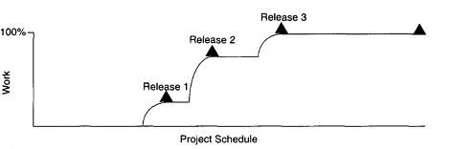
WORK AND PROGRESS - MANAGEMENT INDICATOR
The various activities of an iterative development project can be measured by defining a planned estimate of the work in an objective measure, then tracking progress (work completed over time) against that plan.
Each major organizational team should have at least one primary progress perspective that it is measured against. For the standard teams perspectives of this metric would be as follows:
Software architecture team: use cases demonstrated
Software development team: SLOC under baseline change management, SCOs closed
Software assessment team: SCOs opened, test hours executed, evaluation criteria met
Software management team: milestones completed

Slide 10
BUDGETED COST AND EXPENDITURES - MANAGEMENT INDICATOR
Plan the near-term activities (less than six months) in detail and leave the far-term activities as rough estimates to be refined as the current iteration is winding down and planning for the next iteration becomes crucial.
Financial performance measurement provides highly detailed cost and schedule insight. Its major weakness for software projects to assess the technical progress (% complete) objectively and accurately.

Slide 11
BUDGETED COST AND EXPENDITURES - MANAGEMENT INDICATOR
Modern software processes are amenable to financial performance measurement through an earned value approach. The basic parameters of an earned value system:
Expenditure plan: the planned spending profile for a project over its planned schedule.
Actual progress: technical accomplishment relative to the planned progress underlying the spending profile. In a healthy project, the actual progress tracks planned progress closely.
Actual cost: actual spending profile for a project over its actual schedule. In a healthy project, this profile tracks the planned profile closely.
Earned value: the value that represents the planned cost of the actual progress.
Cost variance: difference between the actual cost and the earned value. Positive values correspond to over-budget and negative values correspond to under-budget situations.
Schedule variance: difference between the planned cost and the earned value. Positive values correspond to behind-schedule situations; negative values correspond to ahead-of-schedule situations.

Slide 12
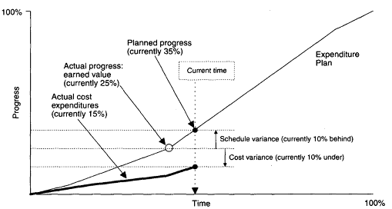
BUDGETED COST AND EXPENDITURES - MANAGEMENT INDICATOR
0 to 50%: content incomplete
50%: draft content; author has completed first draft text and art
65%: initial text baseline; initial text editing complete
75%: reviewable baseline; text and art editing complete
80%: updated baseline; cross-chapter consistency checked
90%: reviewed baseline; author has incorporated external reviewer comments
100%: final edit; editor has completed a final cleanup pass

Slide 13
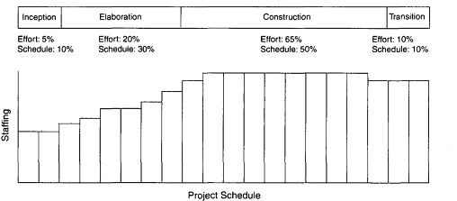
STAFFING AND TEAM DYNAMICS - MANAGEMENT INDICATOR
An iterative development should start with a small team until the risks in the requirements and architecture have been suitably resolved.
Depending on the overlap of iterations and other project-specific circumstances, staffing can vary. For discrete, one of-a-kind development efforts (such as building a corporate information system), the staffing profile in Figure would be typical.

Slide 14
STAFFING AND TEAM DYNAMICS - MANAGEMENT INDICATOR
It is reasonable to expect the maintenance team to be smaller than the development team for these sorts of developments.
For a commercial product development, the sizes of the maintenance and development teams may be the same.
Tracking actual versus planned staffing is a necessary and well-understood management metric. Increases in staff can slow overall project progress as new people consume the productive time of existing people in coming up to speed.
Low attrition of good people is a sign of success.

Slide 15
STAFFING AND TEAM DYNAMICS - MANAGEMENT INDICATOR
Engineers are highly motivated by making progress in getting something to work; this is the recurring theme underlying an efficient iterative development process.
If this motivation is not there, good engineers will migrate elsewhere. An increase in unplanned attrition-namely, people leaving a project prematurely-is one of the most glaring indicators that a project is destined for trouble.
The causes of such attrition can vary, but they are usually personnel dissatisfaction with management methods, lack of teamwork, or probability of failure in meeting the planned objectives.

Slide 16
QUALITY INDICATORS
Change traffic and stability (change traffic over time)
Breakage and modularity (average breakage per change over time)
Rework and adaptability (average rework per change over time)
Mean time between failures (MTBF) and maturity (defect rate over time)

Slide 17
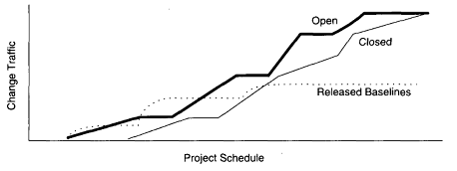
QUALITY INDICATORS
1. CHANGE TRAFFIC AND STABILITY:
It is defined as the number of software change orders opened and closed over the life cycle in the figure.
This metric can be collected by change type, by release, across all releases, by team, by components, by subsystem, and so forth.
Coupled with the work and progress metrics, it provides insight into the stability of the software and its convergence toward stability (or divergence toward instability).
Stability is defined as the relationship between opened versus closed software components.
The change traffic relative to the release schedule provides insight into schedule predictability, which is the primary value of this metric and an indicator of how well the process is performing.

Slide 18
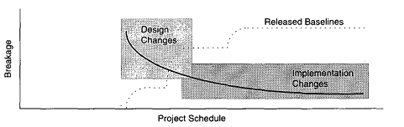
2. BREAKAGE AND MODULARITY
Breakage is defined as the average extent of change, which is the amount of software baseline that needs rework (in SLOC, function points, components, subsystems, files, etc.).
Modularity is the average breakage trend over time. For a healthy project, the trend expectation is decreasing or stable as in figure.
This indicator provides insight into the benign or malignant character of software change.
In a mature iterative development process, earlier changes are expected to result in more scrap than later changes.
Breakage trends that are increasing with time clearly indicate that product maintainability is suspect.

Slide 19
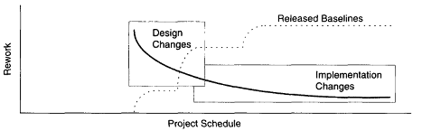
3 REWORK AND ADAPTABILITY:
Rework is the average cost of change, which is the effort to analyze, resolve, and retest all changes to software baselines.
Adaptability is the rework trend over time. For a healthy project, the trend expectation is decreasing or stable as in figure.
Not all changes are created equal. Some changes can be made in a staff-hour, while others take staff-weeks. This metric provides insight into rework measurement.
In a mature iterative development process, earlier changes (architectural changes, which affect multiple components and people) are expected to require more rework than later changes (implementation changes).

Slide 20
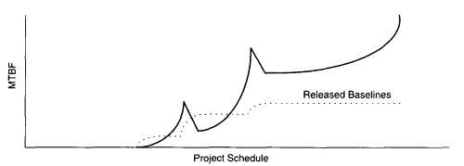
4 MTBF AND MATURITY
MTBF is the average usage time between software faults. In rough terms, MTBF is computed by dividing the test hours by the number of type 0 and type 1 errors.
Maturity is the MTBF trend over time as in figure.
Early insight into maturity requires that an effective test infrastructure be established.
Conventional testing approaches for monolithic software programs focused on achieving complete test coverage of every line of code, every branch.

Slide 21
Software errors categorized into two types: deterministic and non deterministic. Physicists characterize these as Bohr-bugs and Heisen-bugs, respectively.
Bohr-bugs represent a class of errors that always result when the software is stimulated in a certain way. These errors caused by coding errors, and changes are typically isolated to a single component.
Heisen-bugs are software faults that are coincidental with a certain probabilistic occurrence of a given situation. These errors are design errors and typically are not repeatable even when the software is stimulated in the same apparent way.
To provide adequate test coverage and resolve the statistically significant Heisen-bugs, extensive statistical testing under realistic and randomized usage scenarios is necessary.
Modern, distributed systems with numerous interoperating components executing across a network of processors are vulnerable to Heisen-bugs, which are far more complicated to detect, analyze, and resolve.
The best way to mature a software product is to establish an initial test infrastructure that allows execution of randomized usage scenarios early in the life cycle and continuously evolves the breadth and depth of usage scenarios to optimize coverage across the reliability-critical components.

Slide 22
LIFE-CYCLE EXPECTATIONS
The quality indicators are derived from the evolving product rather than from the artifacts.
They provide insight into the waste generated by the process. Scrap and rework metrics are a standard measurement perspective of most manufacturing processes.
They recognize the inherently dynamic nature of an iterative development process. Rather than focus on the value, they explicitly concentrate on the trends or changes with respect to time.
The combination of insight from the current value and the current trend provides tangible indicators for management action.

Slide 23
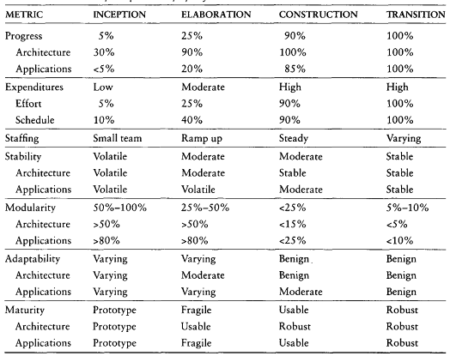
Default pattern of life-cycle metrics evolution

Slide 24
PRAGMATIC SOFTWARE METRICS
Basic characteristics of a good metric are
It is considered meaningful by the customer, manager, and performer.
If anyone of these stakeholders does not see the metric as meaningful, it will not be used. "The customer is always right" is a sales motto, not an engineering tenet.
It demonstrates quantifiable correlation between process perturbations and business performance.
The only real organizational goals and objectives are financial: cost reduction, revenue increase, and margin increase.
It is objective and unambiguously defined.
Objectivity should translate into some form of numeric representation (such as numbers, percentages, ratios) as opposed to textual representations (such as excellent, good, fair, poor).
Ambiguity is minimized through well-understood units of measurement (such as staff-month, SLOe, change, function point, class, scenario, requirement), which are surprisingly hard to define precisely in the software engineering world.

Slide 25
PRAGMATIC SOFTWARE METRICS
It displays trends. This is an important characteristic.
Understanding the change in a metric's value with respect to time, subsequent projects, subsequent releases, and so forth is an extremely important perspective, especially for today's iterative development models. It is very rare that a given metric drives the appropriate action directly.
It is a natural by-product of the process.
The metric does not introduce new artifacts or overhead activities; it is derived directly from the main stream engineering and management workflows.
It is supported by automation.
Experience has demonstrated that the most successful metrics are those that are collected and reported by automated tools, in part because software tools require rigorous definitions of the data they process.

Slide 26
METRICS AUTOMATION
This automation improves management insight into progress and quality trends.
Software project control panel (SPCP) maintains an on-line version of the status of evolving artifacts.
Provide a display panel (Dashboard) that integrates data from multiple sources to show the current status of some aspect of the project.
The panel can support standard features such as warning lights, thresholds, variable scales, digital formats, and analog formats to present an overview of the current status.
SPCP defines and develops the following:
Metrics primitives: indicators, trends, comparisons, and progressions
A graphical user interface: GUI support for a software project manager role and flexibility to support other roles
Metrics collection agents: data extraction from the environment tools that maintain the engineering notations for the various artifact sets
Metrics data management server: data management support for populating the metric displays of the GUI and storing the data extracted by the agents
Metrics definitions: actual metrics presentations for requirements progress , design progress, implementation progress, assessment progress and other progress dimensions.
Actors: typically, the monitor and the administrator

Slide 27
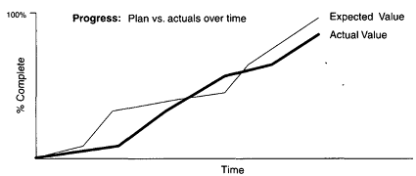
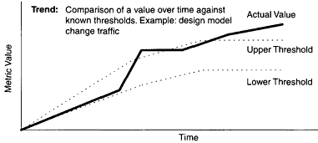
METRICS AUTOMATION
Monitor: defines panel layouts from existing mechanisms, graphical objects, and linkages to project data; queries data to be displayed at different levels of abstraction
Administrator: installs the system; defines new mechanisms, graphical objects, and linkages; handles archiving functions; defines composition and decomposition structures for displaying multiple levels of abstraction
Indicators may display data in formats that are binary (such as black and white), tertiary (such as red, yellow, and green), digital (integer or float), or some other enumerated type (such as sun ..sat, jan ..dec).
A trend graph presents values over time and permits upper and lower thresholds. A progression graph presents elements of progress between states and an earned value is
associated with each state.

Slide 28
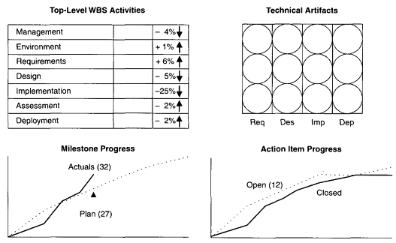
METRICS AUTOMATION
Example: SPCP for a project. software project manager role has defined a top-level display with four graphical objects.
1. Project activity status. The graphical object in the upper left provides an overview of the status of the top-level WBS elements. The seven elements are coded as red, yellow, and green to reflect the current earned value status. Green represents ahead of plan, yellow indicates within 10% of plan, and red identifies elements that have a greater than 10% cost or schedule variance. This graphical object provides several examples of indicators: tertiary colors, the actual percentage, and the current first derivative.

Slide 29
METRICS AUTOMATION
2. Technical artifact status. The graphical object in the upper right provides an overview of the status of the evolving technical artifacts. The Req light would display an assessment of the current state of the use case models and requirements specifications. The Des light would do the same for the design models, the Imp light for the source code baseline, and the Dep light for the test program.
3. Milestone progress. The graphical object in the lower left provides a progress assessment of the achievement of milestones against plan and provides indicators of the current values.
4. Action item progress. The graphical object in the lower right provides a different perspective of progress, showing the current number of open and closed issues.
Basic operational concept for an SPCP to monitor the control panel:
The SPCP starts and shows the most current information .
The user selects from a list of previously defined default panel preferences.
The user selects whether the metric should be displayed for a given point in time or in a graph, as a trend. The default for trends is monthly.
The user points to a graphical object and requests that the control values for that metric and point in time be displayed.
Points to a graphical object displaying a point in time and drills down to view the trend for the metric.
Points to a graphical object displaying a trend and drills down to view the values for the metric.
The user points to a graphical object displaying a point in time and drills down to view the next level of information.
The user points to a graphical object displaying an indicator and drills down to view the breakdown of the next level of indicators.

Slide 30
Tailoring the Process
Process Discriminants
Example: Small-Scale Project Versus Large-scale Project

Slide 31
Process Discriminants
Two primary dimensions of process variability: technical complexity and management complexity
The formality of reviews, the quality control of artifacts, the priorities of concerns, and numerous other process instantiation parameters are governed by the point a project occupies in these two dimensions.
A process framework is must be injected, and the methods, techniques, culture, formality, and organization must be tailored to the specific domain to achieve a success.
The project processes is organized around six process parameters:
Scale,
Stakeholder Cohesion,
Process flexibility,
Process Maturity,
Architectural Risk,
Domain experience

Slide 32
Process Discriminants
Figure shows Two primary dimensions of process variability: technical complexity and management complexity
Higher technical complexity
Embedded, real-time, distributed, fault-tolerant
High-performance, portable
Unprecedented, architecture re-engineering
Average software project
5 to 10 people
10 to 12 months
3 to 5 external interfaces
Some unknowns, risks
Lower management complexity
Smaller scale
Informal
Few stakeholders
“Products”
Higher management complexity
Large scale
Contractual
Many stakeholders
“Projects”
Lower technical complexity
Straightforward automation, single thread
Interactive performance, single platform
Many precedent systems, application re-engineering

Slide 33
Priorities for tailoring the process framework
Higher technical complexity
More domain experience required
Longer inception and elaboration phases
More iterations for risk management
Less-predictable costs and schedules
Lower management complexity
Less emphasis on risk management
Less process formality
More emphasis on individual skills
Longer production and transition phases
Higher management complexity
More emphasis on risk management
More process formality
More emphasis on teamwork
Longer inception and elaboration phases
Lower technical complexity
More emphasis on existing assets
Shorter inception and elaboration phases
Fewer iterations
More-predictable costs and schedules

Slide 34
Scale
Most important factor in tailoring a software process framework is the total scale of the software application. Many ways to measure scale, including number of source lines of code, number of function points, number of use cases, and number of dollars.
From a process tailoring perspective, the primary measure of scale is the size of the team. As the headcount increases, the importance of consistent interpersonal communications becomes paramount.
Five people is an optimal size for an engineering team. Many studies indicate that most people can best manage four to seven things at a time.
Different management approaches needed to manage a team of 1 (trivial), a team of 5 (small), a team of 25 (moderate), a team of 125 (large), a team of 625 (huge), and so on.
As team size grows, a new level of personnel management is introduced at roughly each factor of 5.
Trivial-sized projects require almost no management overhead (planning, communication,
coordination, progress assessment, review, administration). There is little need to document the intermediate artifacts. Workflow is single-threaded. Performance is highly dependent on personnel skills.
Small projects (5 people) require very little management overhead, but team leadership toward a common objective is crucial. Communication is needed among team members. Project milestones are easily planned, informally conducted, and easily changed. There is a small number of individual workflows. Performance depends primarily on personnel skills. Process maturity is relatively unimportant. Individual tools can have a considerable impact on performance.

Slide 35
Moderate-sized projects (25 people) require moderate management overhead, including a dedicated software project manager to synchronize team workflows and balance resources. Overhead workflows across all team leads are necessary for review, coordination, and assessment.
There is a definite need to communicate the intermediate artifacts among teams.
Project milestones are formally planned and conducted, and the impacts of changes are typically benign. There is a small number of concurrent team workflows, each with multiple individual workflows.
Performance is highly dependent on the skills of key personnel, especially team leads. Process maturity is valuable. An environment can have a considerable impact on performance, but success can be achieved with certain key tools in place.
Large projects (125 people) require substantial management overhead, including a dedicated software project manager and several subproject managers to synchronize project-level and subproject-level workflows and to balance resources.
There is significant expenditure in overhead workflows across all team leads for dissemination, review, coordination, and assessment. Intermediate artifacts are explicitly emphasized to communicate engineering results across many diverse teams.
Project milestones are formally planned and conducted, and changes to milestone plans are expensive. Large numbers of concurrent team workflows are necessary, each with multiple individual workflows.
Performance is highly dependent on the skills of key personnel, especially subproject managers and team leads.

Slide 36
Project performance is dependent on average people, for two reasons:
There are numerous mundane jobs in any large project, especially in the overhead workflows.
The probability of recruiting, maintaining, and retaining a large number of exceptional people is small.
Huge projects (625 people) require substantial management overhead, including multiple software project managers and many subproject managers to synchronize project-level and subproject-level workflows and to balance resources.
There is significant expenditure in overhead workflows across all team leads for dissemination, review, coordination, and assessment. Intermediate artifacts are explicitly emphasized to communicate engineering results across many diverse teams.
Project milestones are very formally planned and conducted, and changes to milestone plans typically cause malignant re-planning. There are very large numbers of concurrent team workflows, each with multiple individual workflows. Performance is highly dependent on the
skills of key personnel, especially subproject managers and team leads.
Software process maturity and domain experience are mandatory to avoid risks and ensure synchronization of expectations across numerous stakeholders.
A mature, highly integrated, common environment across the development teams is necessary to manage change, automate artifact production, maintain consistency among the evolving artifacts, and improve the return on investment of common processes, common tools, common notations, and common metrics.

Slide 37
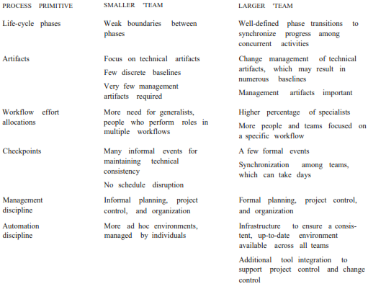
Table: Process discriminators that result from differences in project size

Slide 38
2. STAKEHOLDER COHESION OR CONTENTION
The degree of cooperation and coordination among stakeholders (buyers, developers, users, subcontractors, and maintainers, among others) can significantly drive the specifics of how a process is defined.
Cohesive teams have common goals, complementary skills, and close communications. Adversarial teams have conflicting goals, competing or incomplete skills, and less-than-open communications.
A product that is funded, developed, marketed, and sold by the same organization can be set up with a common goal (for example, profitability). A small, collocated organization can be established that has a cohesive skill base and excellent day-to-day communications among team members.
It is much more difficult to set up a large contractual effort without some contention across teams. A development contractor rarely has all the necessary software or domain expertise and frequently must team with multiple subcontractors, who have competing profit goals.
Funding authorities and users want to minimize cost, maximize the feature set, and accelerate time to market, while development contractors want to maximize profitability.
Large teams are almost impossible to collocate, and synchronizing stakeholder expectations is challenging. All these factors tend to degrade team cohesion and must be managed continuously.

Slide 39
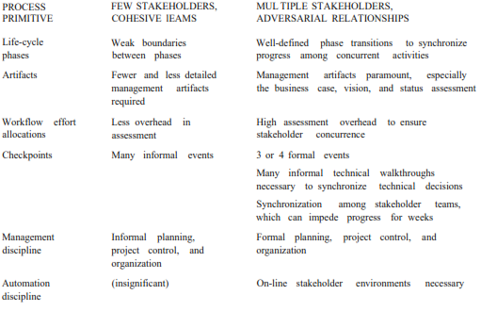
Table: Process discriminators that result from differences in stakeholder cohesion

Slide 40
3. PROCESS FLEXIBILITY OR RIGOR
The degree of rigor, formality, and change freedom inherent in a specific project's "contract" (vision document, business case, and development plan) will have a substantial impact on the implementation of the project's process.
For very loose contracts such as building a commercial product within a business unit of a software company, management complexity is less. In this, processes, features, time to market, budget, quality can freely traded off and changed with little overhead.
For example, if a company wanted to eliminate a few features in a product under development to capture market share from the competition by accelerating the product release, it would be feasible to make this decision in less than a week. The entire coordination effort might involve only the development manager, marketing manager, and business unit manager coordinating some key commitments.
For a very rigorous contract, it could take many months to authorize a change in a release schedule.
For example, to avoid a large custom development effort, it might be desirable to incorporate a new commercial product into the overall design of a next-generation air traffic control system. This require coordination among the development contractor, funding agency, users, certification agencies, associate contractors for interfacing systems.
Large-scale, catastrophic cost-of-failure systems have extensive contractual rigor and require significantly different management approaches.

Slide 41
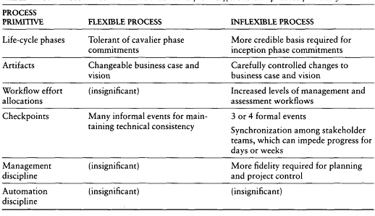
Table: Process discriminators that result from differences in process flexibility

Slide 42
4. PROCESS MATURITY
The process maturity level of the development organization, as defined by the Software Engineering Institute's Capability Maturity Model is another key driver of management complexity.
Managing a mature process (level 3 or higher) is far simpler than managing an immature process (levels 1 and 2).
Organizations with a mature process typically have a high level of precedent experience in developing software and a high level of existing process collateral that enables predictable planning and execution of the process.
This sort of collateral includes well defined methods, process automation tools, trained personnel, planning metrics, artifact templates, and workflow templates.
Tailoring a mature organization‘s process for a specific project is generally a straightforward

Slide 43
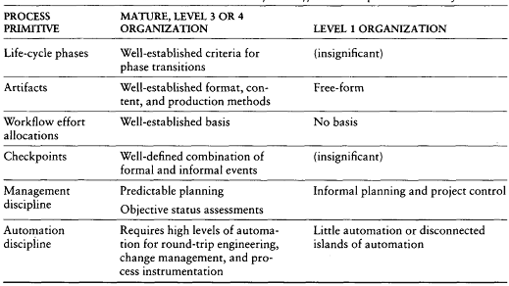
Table: Process discriminators that result from differences in process maturity

Slide 44
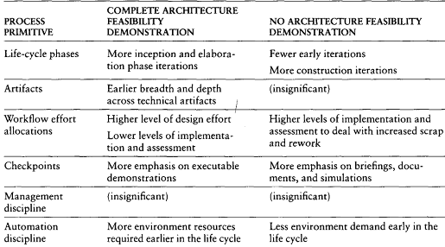
5. ARCHITECTURAL RISK
Some of the most important and recurring sources are system performance (resource utilization, response time, throughput, accuracy), robustness to change (addition of new features, incorporation of new technology, adaptation to dynamic operational conditions), and system reliability (predictable behavior, fault tolerance).
The degree to which these risks can be eliminated before construction begins can have dramatic ramifications in the process tailoring.

Slide 45
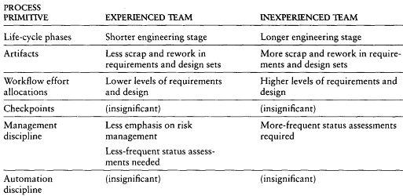
6. DOMAIN EXPERIENCE
Domain experience governs its ability to converge on an acceptable architecture in a minimum number of iterations. An organization that has built five generations of radar control switches may be able to converge on an adequate baseline architecture for a new radar application in two or three prototype release iterations.
A skilled software organization building its first radar application may require four or five prototype releases before converging on an adequate baseline.

Slide 46
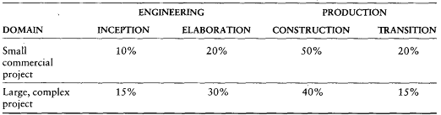
Example: Small-Scale Project vs. Large-Scale Project
some of the dimensions of flexibility, priority, fidelity that can change when a process framework is applied to different (small / large)applications, projects, and domains.
Table illustrates the differences in schedule distribution for large and small projects across the life-cycle phases.
A small commercial project (for example, a 50,000 source-line Visual Basic Windows application, built by a team of five) may require only 1 month of inception, 2 months of elaboration, 5 months of construction, and 2 months of transition.
A large, complex project (for example, a 300,000 source-line embedded avionics program, built by a team of 40) could require 8 months of inception, 14 months of elaboration, 20 months of construction, and 8 months of transition.

Slide 47
Example: Small-Scale Project vs. Large-Scale Project
some of the dimensions of flexibility, priority, fidelity that can change when a process framework is applied to different (small / large)applications, projects, and domains.
Table illustrates the differences in schedule distribution for large and small projects across the life-cycle phases.
A small commercial project (for example, a 50,000 source-line Visual Basic Windows application, built by a team of five) may require only 1 month of inception, 2 months of elaboration, 5 months of construction, and 2 months of transition.
A large, complex project (for example, a 300,000 source-line embedded avionics program, built by a team of 40) could require 8 months of inception, 14 months of elaboration, 20 months of construction, and 8 months of transition.

Slide 48
Example: Small-Scale Project vs. Large-Scale Project
The success or failure of the project reflects the importance of staffing or the level of associated risk management.
Differences in workflow priorities between small and large projects
Rank | Small Commercial Project | Large Complex Project
1 | Design | Management
2 | Implementation | Design
3 | Deployment | Requirements
4 | Requirements | Assessment
5 | Assessments | Environment
6 | Management | Implementation
7 | Environment | Deployment

Slide 49
Example: Small-Scale Project vs. Large-Scale Project
The following list elaborates some of the key differences in discriminators of success.
Design is key in both domains. Good design of a commercial product is a key differentiator in the marketplace and is the foundation for efficient new product releases. Good design of a large, complex project is the foundation for predictable, cost-efficient construction.
Management is paramount in large projects, where the consequences of planning errors, resource allocation errors, inconsistent stakeholder expectations, and other out-of-balance factors can have catastrophic consequences for the overall team dynamics. Management is far less important in a small team, where opportunities for miscommunications are fewer and their consequences less significant.
Deployment plays a far greater role for a small commercial product because there is a broad user base of diverse individuals and environments.

Slide 50
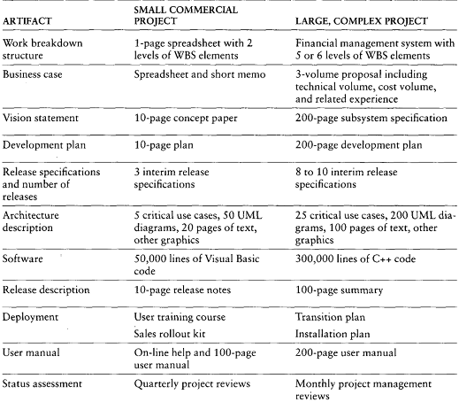
Differences in artifacts between small and large projects

Slide 51
Reference
Software Project Management - A Unified Framework Walker Royce

Slide 52
Looking Forward Table of Contents
Modern Project Profiles
Continuous Integration
Early Risk Resolution
Evolutionary Requirements
Teamwork Among Stakeholders
Top 10 Software Management Principles
Software Management Best Practices
Next-Generation Software Economics
Next-Generation Cost Models
Modern Software Economics
Modern Process Transitions
Culture Shifts
Denouement

Slide 53
Modern Project Profiles Continuous Integration
Differences in workflow cost allocations between
a conventional process and a modern process
SOFTWARE ENGINEERING WORKFLOWS | CONVENTIONAL PROCESS EXPENDITURES | MODERN PROCESS EXPENDITURES
Management | 5% | 10%
Environment | 5% | 10%
Requirements | 5% | 10%
Design | 10% | 15%
Implementation | 30% | 25%
Assessment | 40% | 25%
Deployment | 5% | 5%
Total | 100% | 100%

Slide 54
Modern Project Profiles Continuous Integration
The continuous integration inherent in an iterative
development process enables better insight into
quality trade-offs.
System characteristics that are largely inherent
in the architecture (performance, fault tolerance,
maintainability) are tangible earlier in the process,
when issues are still correctable.

Slide 55
Modern Project Profiles Early Risk Resolution
Conventional projects usually do the easy stuff first,
modern process attacks the important 20%
of the requirements, use cases, components, and risks.
The effect of the overall life-cycle philosophy
on the 80/20 lessons provides a useful risk management
perspective.
80% of the engineering is consumed by 20% of the requirements.
80% of the software cost is consumed by 20% of the components.
80% of the errors are caused by 20% of the components.
80% of the progress is made by 20% of the people.

Slide 56
Modern Project Profiles Evolutionary Requirements
Conventional approaches decomposed system requirements
into subsystem requirements, subsystem requirements into
component requirements, and component requirements into
unit requirements.
The organization of requirements was structured
so traceability was simple.
Most modern architectures that use commercial components,
legacy components, distributed resources and
object-oriented methods are not trivially traced
to the requirements they satisfy.
The artifacts are now intended to evolve along with the process,
with more and more fidelity as the life-cycle progresses and
the requirements understanding matures.

Slide 57
Modern Project Profiles Teamwork among stakeholders
Many aspects of the classic development process cause
stakeholder relationships to degenerate into mutual distrust,
making it difficult to balance requirements, product features,
and plans.
The process with more-effective working relationships between
stakeholders requires that customers, users and monitors have both
applications and software expertise, remain focused on the delivery
of a usable system
It also requires a development organization that is focused
on achieving customer satisfaction and high product quality
in a profitable manner.
The transition from the exchange of mostly paper artifacts
to demonstration of intermediate results is one of the crucial
mechanisms for promoting teamwork among stakeholders.

Slide 58
Modern Project Profiles Top 10 Software Management Principles
1. Base the process on an architecture-first approach – rework rates remain stable over the project life cycle.
2. Establish an iterative life-cycle process that confronts
risk early
3. Transition design methods to emphasize component-based development
4. Establish a change management environment – the dynamics
of iterative development, including concurrent workflows by
different teams working on shared artifacts, necessitate highly controlled baselines
5. Enhance change freedom through tools that support
round-trip engineering

Slide 59
Modern Project Profiles Top 10 Software Management Principles
6. Capture design artifacts in rigorous, model-based notation
7. Instrument the process for objective quality control and progress assessment
8. Use a demonstration-based approach to asses intermediate artifacts
9. Plan intermediate releases in groups of usage scenarios with evolving levels of detail
10. Establish a configurable process that is economically
scalable

Slide 60
Modern Project Profiles Software Management Best Practices
There is nine best practices:
1. Formal risk management
2. Agreement on interfaces
3. Formal inspections
4. Metric-based scheduling and management
5. Binary quality gates at the inch-pebble level
6. Program-wide visibility of progress versus plan.
7. Defect tracking against quality targets
8. Configuration management
9. People-aware management accountability

Slide 61
Next-Generation Software Economics Next-Generation Cost Models
Software experts hold widely varying opinions about software economics and its manifestation in software cost estimation models:
source lines of code
function points
productivity
measures
quality
measures
VERSUS
Java
C++
object-oriented
functionally oriented
It will be difficult to improve empirical estimation models while
the project data going into these models are noisy
and highly uncorrelated, and are based on differing process
and technology foundations.

Slide 62
Next-Generation Software Economics Next-Generation Cost Models
Some of today’s popular software cost models are not well matched
to an iterative software process focused an architecture-first approach
Many cost estimators are still using a conventional process experience
base to estimate a modern project profile
A next-generation software cost model should explicitly separate
architectural engineering from application production,
just as an architecture-first process does.
Two major improvements in next-generation software
cost estimation models:
Separation of the engineering stage from the production stage
will force estimators to differentiate between architectural scale and implementation size.
Rigorous design notations such as UML will offer an opportunity
to define units of measure for scale that are more standardized and
therefore can be automated and tracked.

Slide 63
Next-Generation Software Economics Modern Software Economics
Changes that provide a good description of what an organizational manager should strive for in making the transition to a modern process:
1. Finding and fixing a software problem after delivery
costs 100 times more than fixing the problem in early design phases
2. You can compress software development schedules 25% of nominal, but no more.
3. For every $1 you spend on development,
you will spend $2 on maintenance.
4. Software development and maintenance costs are primarily
a function of the number of source lines of code.

Slide 64
Next-Generation Software Economics Modern Software Economics
5. Variations among people account for the biggest differences
in software productivity.
6. The overall ratio of software to hardware costs
is still growing – in 1955 it was 15:85; in 1985 85:15.
7. Only about 15% of software development effort
is devoted to programming.
8. Software systems and products typically cost 3 times
as much per SLOC as individual software programs.
9. Walkthroughs catch 60% of the errors.
10. 80% of the contribution comes from 20% of the
contributors.

Slide 65
Modern Process Transitions Culture Shifts
Several culture shifts must be overcome to transition successfully to a modern software management process:
Lower level and mid-level managers are performers
Requirements and designs are fluid and tangible
Good and bad project performance is much more obvious earlier
in the life cycle
Artifacts are less important early, more important later
Real issues are surfaced and resolved systematically
Quality assurance is everyone’s job, not a separate discipline
Performance issues arise early in the life cycle
Investments in automation is necessary
Good software organization should be more profitable

Slide 66
Modern Process Transitions Denouement
Good way to transition to a more mature iterative development process that supports automation technologies
and modern architectures is to take the following shot:
Ready.
Do your homework. Analyze modern approaches and technologies.
Define your process. Support it with mature environments, tools,
and components. Plan thoroughly.
Aim.
Select a critical project. Staff it with the right team
of complementary resources and demand improved results.
Fire.
Execute the organizational and project-level plans with vigor and
follow-through.

